Slide 1





Cmake Build Framework – Part 2
C++ Set-Up for Algo Quant Trading
By Nicholas Burgess

Slide 2

C++ Set-Up for Algo Quant Trading
Part 1 – Visual Studio for Windows
Online C++ Emulators & Code Snippets
Visual Studio Projects & Solutions
C++ Building, Compilation & Linking
Part 2 – CMake for Cross-platform Builds
The CMake Build System
How to use CMake
Build Environments & Compilers
Example: Visual Studio & CMake https://github.com/nburgessx/QuantResearch/tree/main/CMake%20Examples

Slide 3
CMake Build Framework – Part 2

Slide 4

CMake Cross-Platform Build System
CMake – What it is and what it does
A cross-platform build system – not a compiler
It uses platform-independent configuration files, CMakeLists.txt
Generates native build files e.g. Visual Studio Solutions, Linux Make files, Ninja files, macOS Xcode projects
Available as part of Visual Studio, see Tools -> Command line -> Developer Command Prompt
How to generate the solution File using Visual Studio?
Create the necessary CMakeLists.txt files
Open Visual Studio command line and type:

Slide 5
CMake Config Files – CMakeLists.txt
Creating CMakeLists.txt Files – A summary of main CMake commands
Solution Config File
Name the solution file (project) and specify what projects to include (add_subdirectory)
Project Config Files
Name the project and list the .h and .cpp files to include (add_library | add_executable)
We provide the path to the include folder(s) with our header files (target_include_directories)
List any dependency projects to include (target_link_libraries)

Slide 6
Example Cake Solution G
CMake – What it is and what it does
A cross-platform build system – not a compiler
It uses platform-independent configuration files, CMakeLists.txt
Generates native build files e.g. Visual Studio Solutions, Linux Make files, Ninja files, macOS Xcode projects
Available as part of Visual Studio, see Tools -> Command line -> Developer Command Prompt
How to generate the solution File using Visual Studio?
Create the necessary CMakeLists.txt files
Open Visual Studio command line and type:

Slide 7
Example: Create Solution File
Consider a simple C++ maths library where the main project is called Analytics that depends on two projects named Addition and Subtraction. The folder structure looks as follows,
MathLibrary (Root Folder)
CMakeLists.txt
Analytics
CMakeLists.txt | Main.cpp
Addition
CMakeLists.txt | Add.h | Add.cpp
Subtraction
CMakeLists.txt | Subtract.h | Subtract.cpp
The solution root folder and each project folder requires a CMakeLists.txt config file
The config file defines the project type, include paths and project dependencies

Slide 8
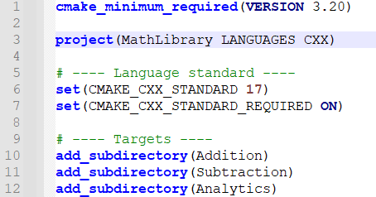
Solution Config File, CMakeLists.txt
project – Name of the solution file
add_subdirectory – List project folders to include

Slide 9
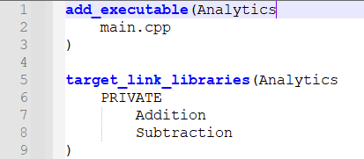
Main Project Config File, CMakeLists.txt
add_executable
Creates project that outputs an executable called Analytics.
List all the .h and .cpp files to include.
add_subdirectory
List the project name then the dependency projects to include
Here we add the addition and subtraction projects to the analytics project

Slide 10
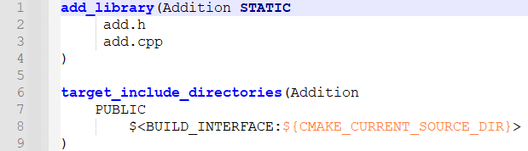
Dependency Project Config File, CMakeLists.txt
add_library
Creates a project named Addition. Use STATIC to generate a .lib and SHARED to generate a .dll
List all the .h and .cpp files to include.
target_include_directories
List the include directories for the Addition project
$(CMAKE_CURRENT_SOURCE_DIR) means use the current folder

Slide 11
Generating the Visual Studio Solution File
How to generate the solution File using Visual Studio?
Create the necessary CMakeLists.txt files
Open Visual Studio command prompt and navigate to the solution root folder
Type mkdir build to create a folder called ‘build’
Navigate to the build folder cd build
To generate the solution file type: cmake –G “Visual Studio 17 2022” ..
Note “..” means the root project is up one folder level
How to generate the native build projects on non-windows platforms and compilers?
Change the name of the compiler from “Visual Studio 17 2022” to the compiler of your choice
Examples: For Linux “Unix Makefiles” or “Ninja” and for macOS use “Xcode”

Slide 12
CMake Resources

Slide 13

Getting Started with CMake
Professional C++ with CMake
Outlines how professional Quants use CMake
Includes canonical stylized working examples
Intentionally simple and easy to follow
Link: https://algoquanthub.beehiiv.com/p/professional-c-with-cmake-for-quants-algo-trading
Examples: https://github.com/nburgessx/QuantResearch/tree/main/CMake%20Examples

Slide 14
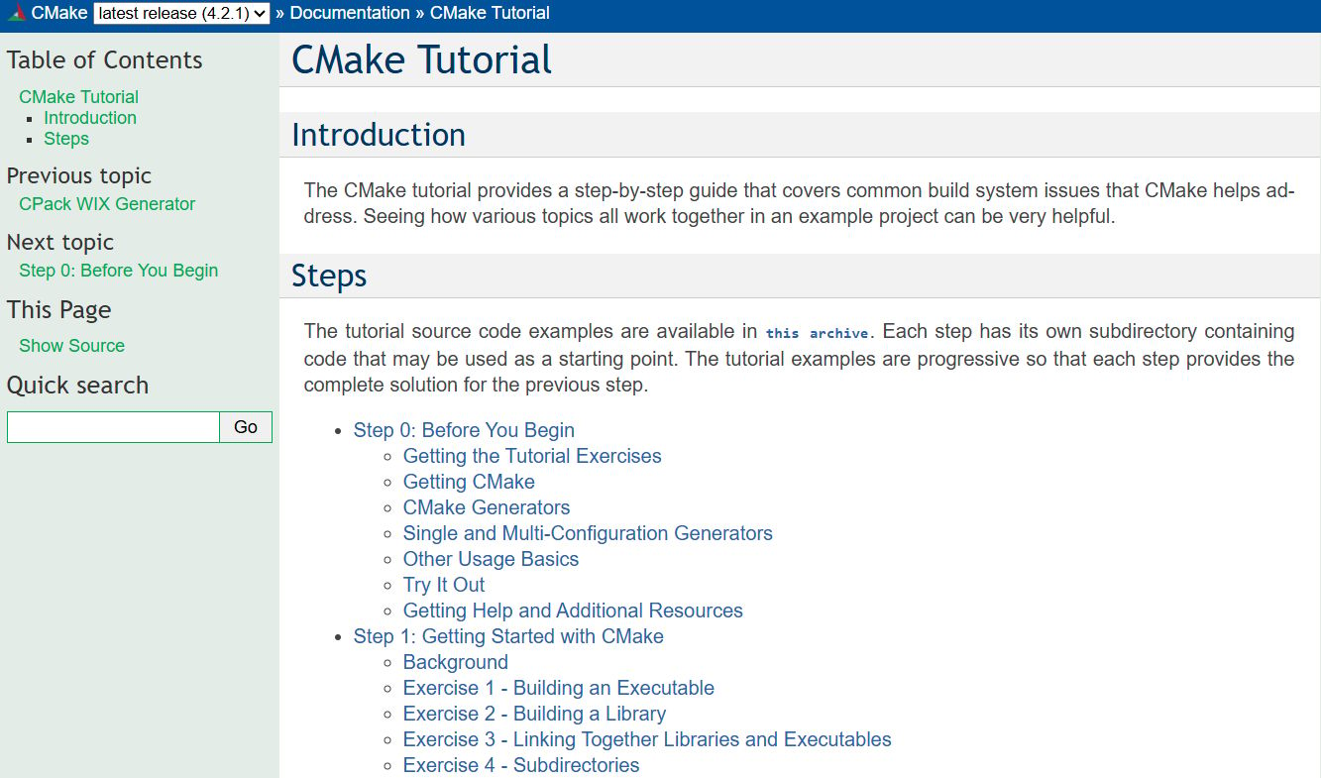
CMake Tutorial – cmake.org
CMake Tutorial – cmake.org
Provides a step-by-step guides and tutorials on how to use CMake

Slide 15

Professional CMake
Professional CMake – A Practical Guide
Free Book
By Craig Scott
https://crascit.com/professional-cmake/

Slide 16
More Info …

Slide 17




Subscribe to my Quant Newsletter
https://algoquanthub.beehiiv.com/subscribe
Subscribe to my Quant YouTube Channel
https://www.youtube.com/@algoquanthub
Algo Trading & Quant Store
https://payhip.com/AlgoQuantHub
Follow me on LinkedIn
https://www.linkedin.com/in/nburgessx

Slide 18
Contact
Have questions or want further info?
LinkedIn: www.linkedin.com/in/nburgessx

